Slide 1
Write a program to demonstrate the working of the decision tree based ID3 algorithm. Use an appropriate dataset for building the decision tree and apply this knowledge to classify a new sample.
ML – Practical 5A

Slide 2
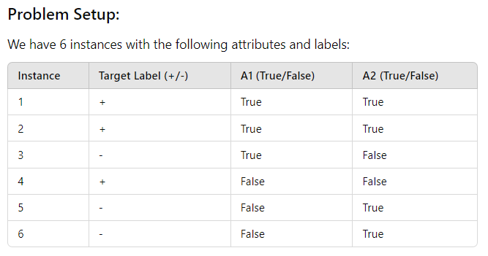
What is ID3 algorithm?

Slide 3
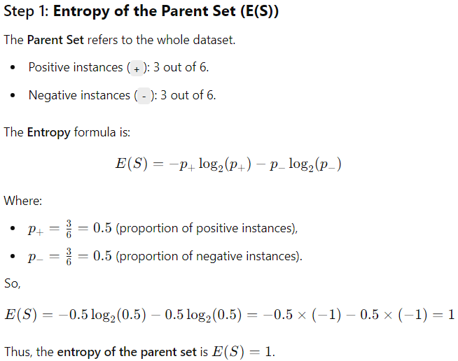


Slide 4
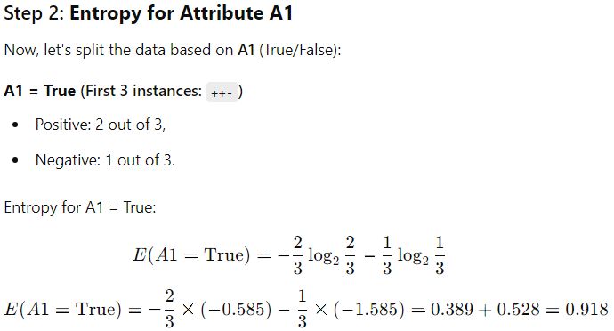

Slide 5
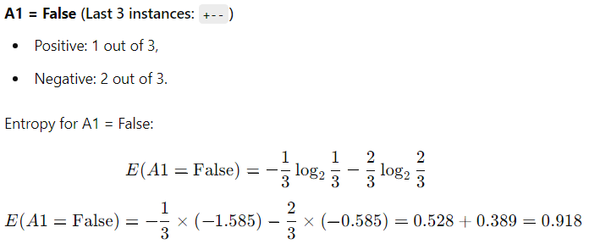

Slide 6
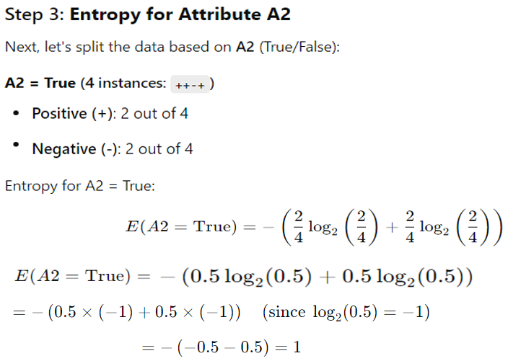

Slide 7
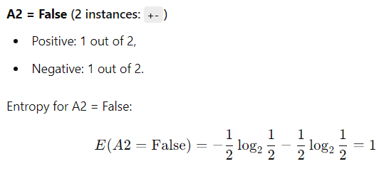

Slide 8
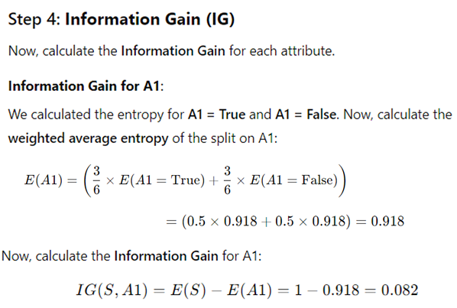

Slide 9
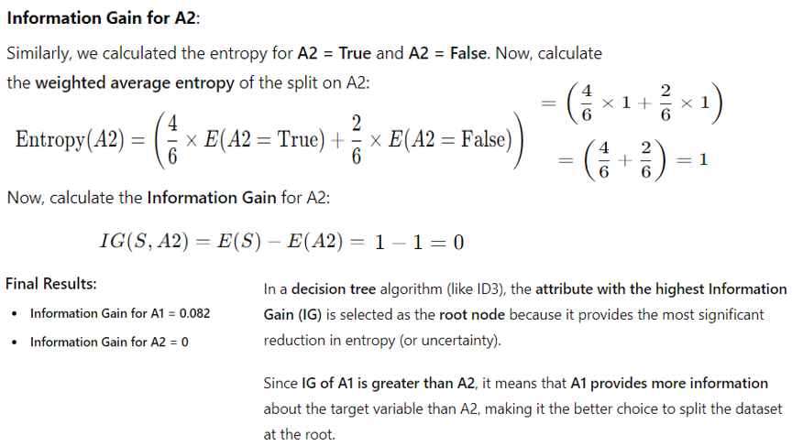

Slide 10


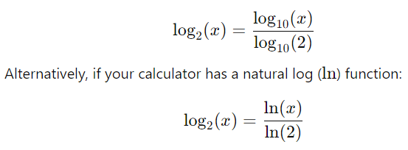
How we calculate :

Slide 11
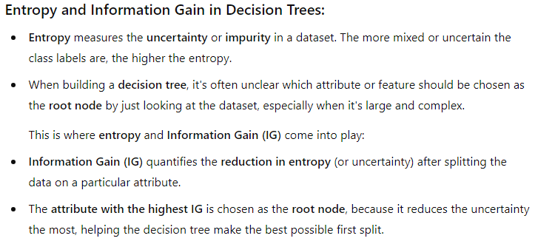

Slide 12





Now, coming to practical:-

Slide 13






Slide 14





Slide 15



Slide 16
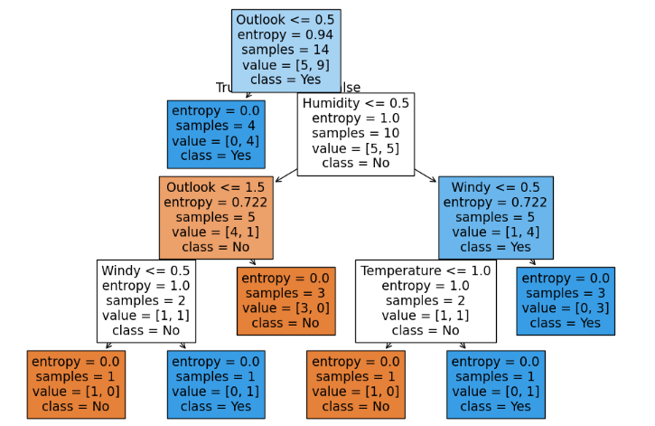

Slide 17
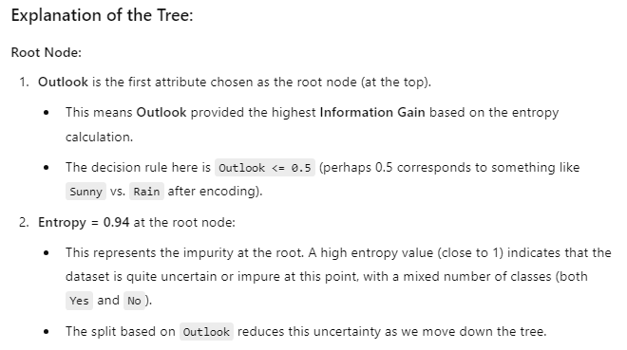

Slide 18
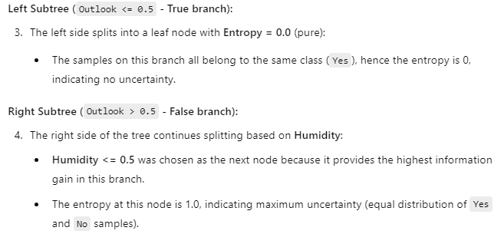

Slide 19



Slide 20
Write a program to implement k-nearest algorithm to classify the iris dataset.
ML – Practical 5 B

Slide 21




Slide 22

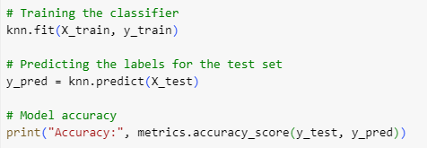

Slide 23




